Slide 1
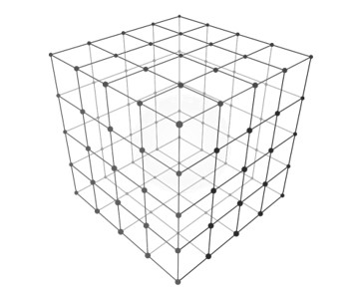
Three-Dimensional Network-on-Chip Architectures for Cycle Accurate Full-System Simulator
Presented By:
Akash Agarwal
OSU ID: 933-471-097
agarwaak@oregonstate.edu
Under the Supervision of
Dr. Lizhong Chen
Assistant Professor
EECS, Oregon State University

Slide 2
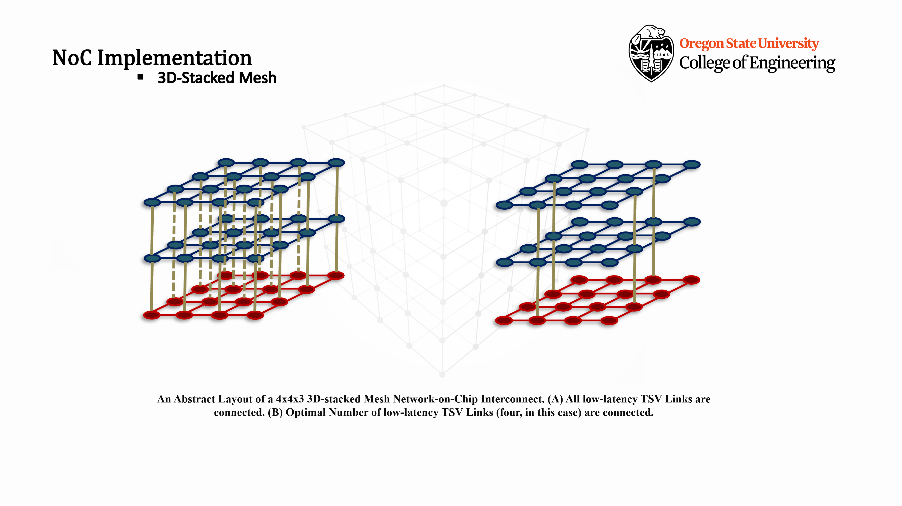
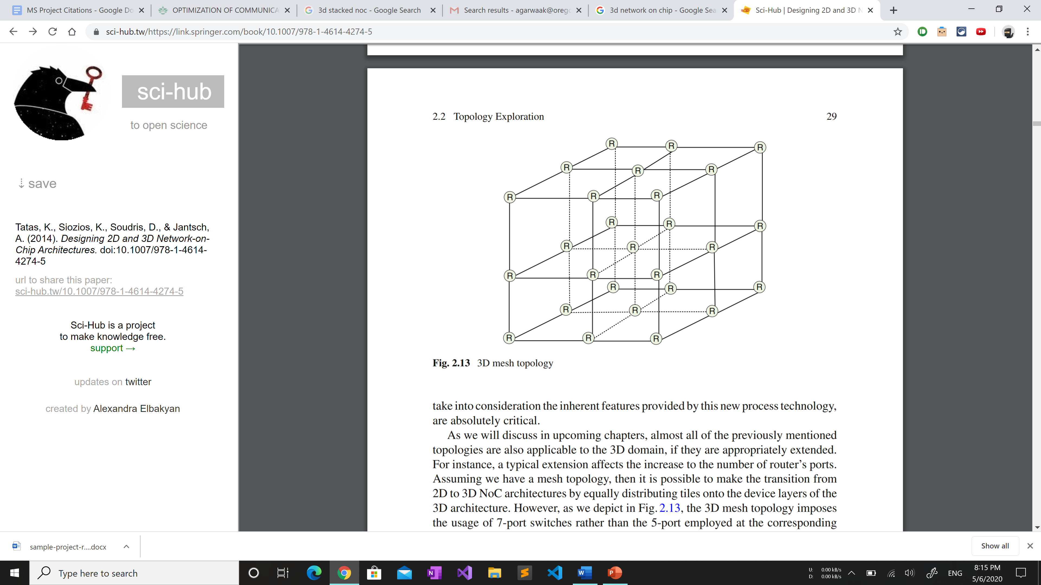
Contents
Introduction
Related Work
3D Die-Stacking Techniques
3D Architectures for Multi-Core
Through Silicon Vias Placement
Garnet Network Model
Three-dimensional NoC Implementation
3D Mesh NoC
3D-stacked Mesh NoC
Optimal TSV-Link Placement
Program Flow
Simulation Results
Conclusion and Future Work
References

Slide 3
Introduction
Moore’s Observation + Dennard Scaling
Many-core research led to the development of:
Shared-Memory Multiprocessor and Distributed Memory architectures.
Moore: Number of transistors in a dense integrated circuit can double approximately every two years.
Dennard: Voltage and current should be proportional to the linear dimensions of a transistor.
Thus, as the number of transistors per die increased, the power density remained relatively constant and in proportion with the area of the die.
⇒ Powering Single-Core Processors by incrementing the clock frequencies without significantly increasing the circuit’s power consumption.
Dennard scaling ignored the “leakage current” and “threshold voltage”, which establish a baseline of power per transistor.
This slowed-down Moore’s Law and created a Power Wall.
Led to advent of new architectures (multi-core CPUs, massively parallel CPUs and special purpose processing devices).
Multiple Cores Deliver more Performance/Watt.
Rise of Multi-core Architectures
Systems with no shared memory.
Each CPU must have its own copy of the operating system, and processes can only communicate through message passing
Multiple CPUs “sharing” the same main memory.
Each process can read and write a data item simply using load and store operations, and process communication is through shared memory
Comparing Memory Architectures
Notes:
NOTES:
(
Need this slide to indicate why are we even discussing the 3D NoCs?
Flow-> Moore’s law + Dennard scaling; fall of the relationship; Multi-Core era; shared memory; CMP; NoC importance; Impact of Topology; 3D Topology era begins…
)
Before starting our course of discussion, let us understand the need for Network-On-Chip research in the first place.
Computer Architecture research had been pre-dominantly focused on powering single-core processors, exploiting the relationship between Moore’s law and Dennard’s Scaling law.
This relationship cannot be understated. Moore observed that the number of transistors in a dense integrated circuit can double approximately every two years. Dennard claimed that the voltage and current reflect proportional relationship with the dimensions of the transistors.
Thus, the Dennard scaling related to the Moore’s law by fact that the performance per watt of computing grows exponentially at roughly the same rate. Hence, as the number of transistors per die increased, the power density remained relatively constant and in proportion with the area of the die.
This enabled the chip manufacturers to increment the clock frequencies without significantly increasing the circuit’s power consumption.
Although this arrangement worked fine for many years, the problem was that the Dennard scaling ignored the “leakage current”, which established a baseline of power per transistor.
The breakdown of Dennard’s scaling also caused the slow-down of Moore’s law and forced computer architects to develop creative architectures to continue delivering performance. This led to the advent of new Architectures (multi-core CPUs, massively parallel CPUs and special purpose processing devices).
Many (simple) cores at lower clock frequency are more power efficient and hence can deliver more Performance/Watt.
Many-core research led to the development of two main types of architectures: Shared-Memory and Distributed Memory architectures.
Explain each architecture from the slide.

Slide 4
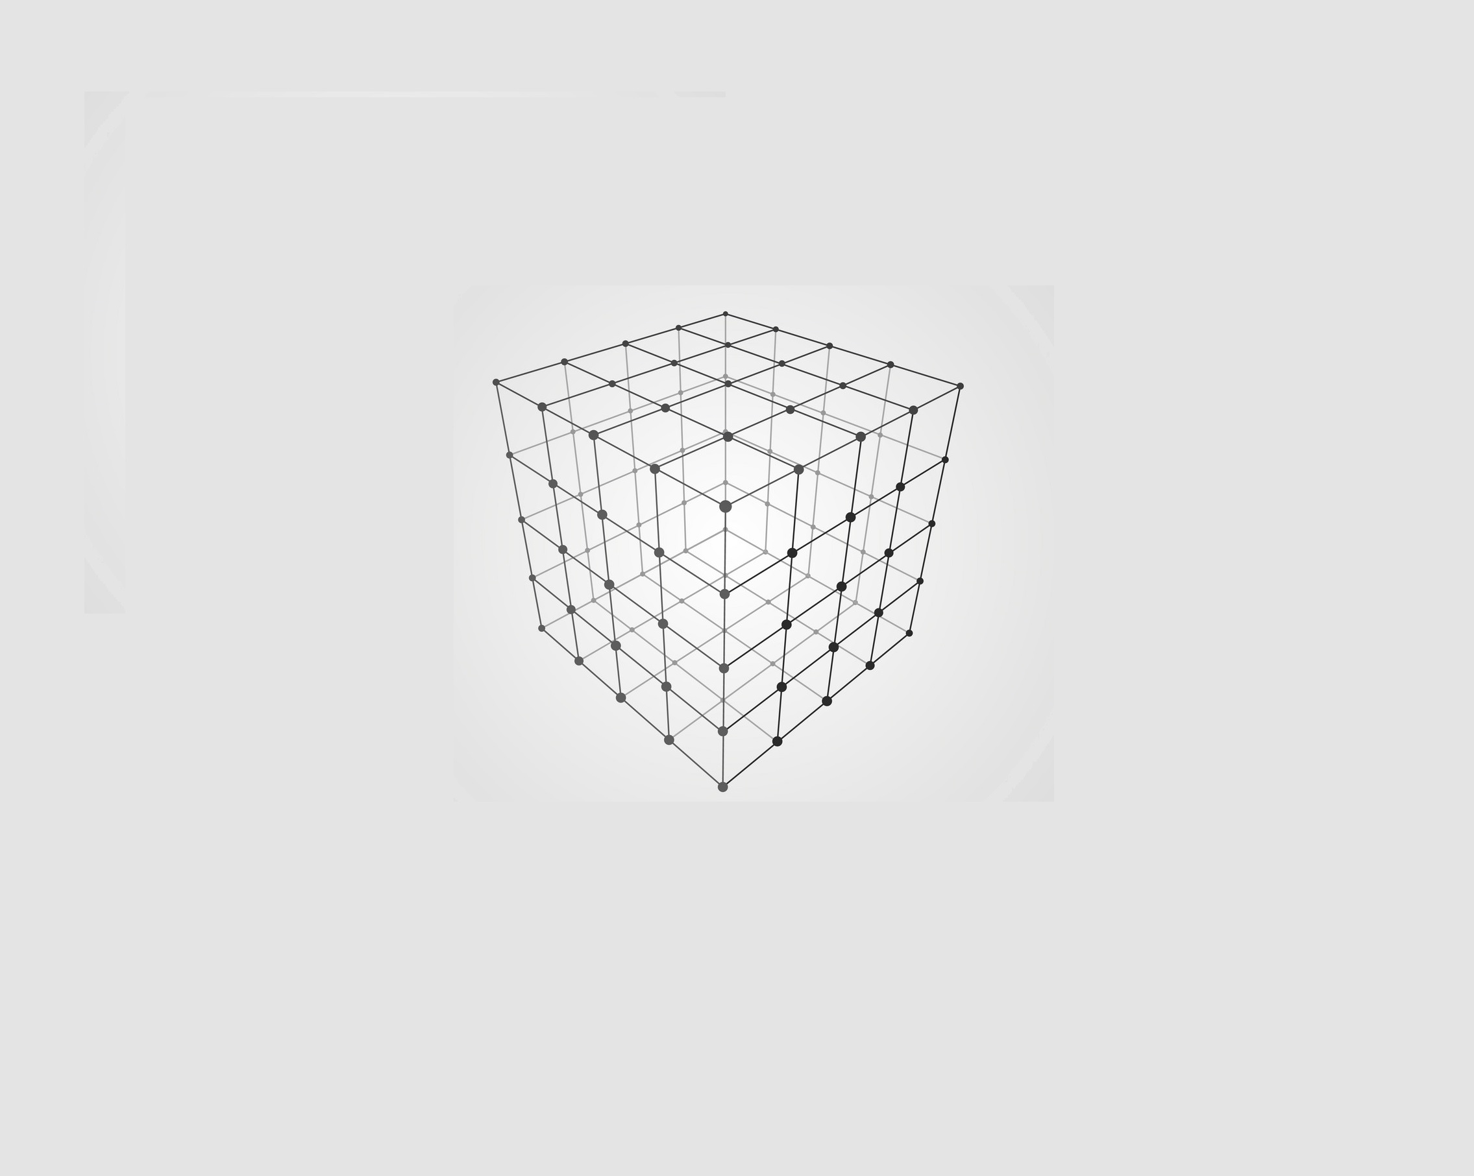
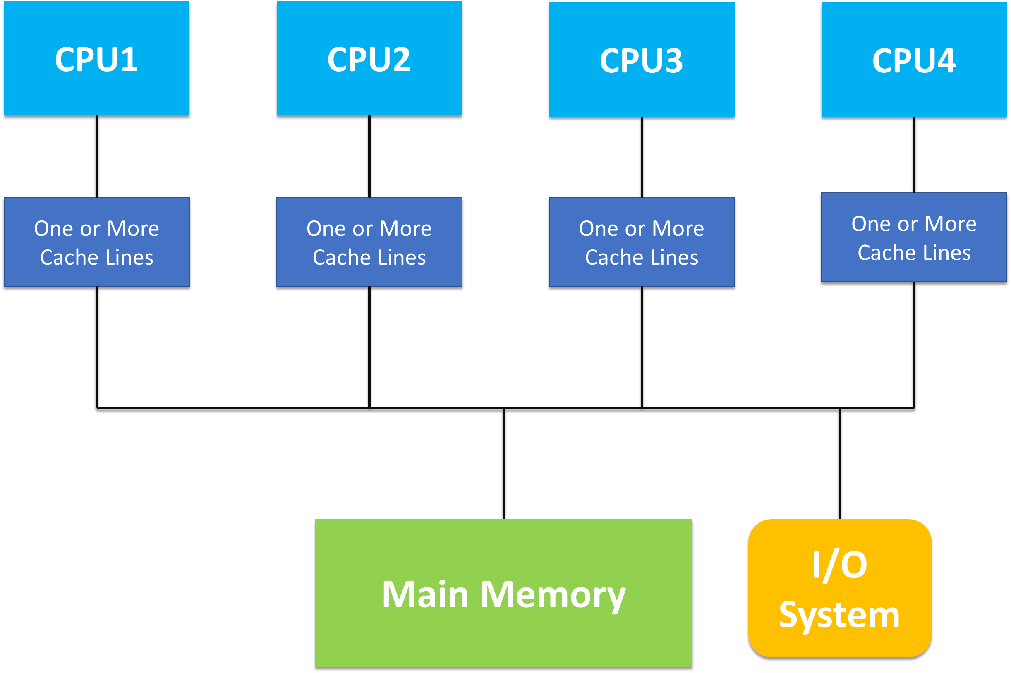
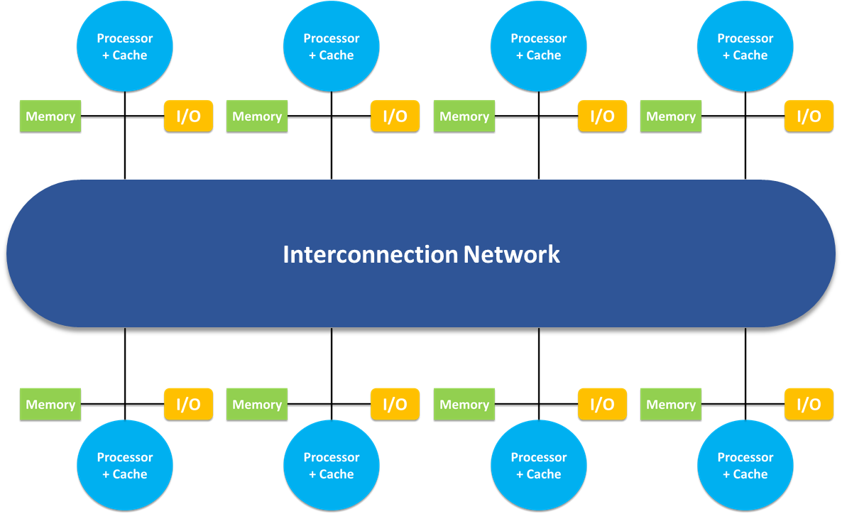
Shared Memory Multiprocessors
Uniform Memory Access (UMA) systems
Non-Uniform Memory Access (NUMA) systems
All processors share a unique centralized primary memory.
CPUs have same memory access time.
Less Scalable.
Physical memory is distributed among CPUs.
Access time to data depends on data position, in local or in a remote memory.
Concept used in Chip-Multiprocessors (CMPs).
Notes:
NOTES:
(
Need this slide to list differences between UMA and NUMA system architectures.
Flow-> Explain UMA flowchart – Explain NUMA flowchart (with comparison from former) – Difference between UMA and NUMA – next slide.
)
Shared Memory Multiprocessors are generally sub-categorized into the following two types of systems: UMA and NUMA systems.
-> Explain difference between UMA and NUMA.
UMA less scalable
UMA has single memory controller
UMA provides equal memory access time
Limited bandwidth in UMA.

Slide 5
CMPs: Multiple cores on single chip, connected using on-chip Interconnect.
Interconnections Network became bottleneck in performance.
One Aspect for NoC Performance Improvement: NoC Topology.
Recent Research in 3D Topologies.
D2D low latency vias in 3D NoCs help to increase the memory locality even further and hence reduces the cache access time, thus improving performance.
Notes:
NOTES:
(
Need this slide to explain Chip Multiprocessors that inherit NUMA architectures. Also prove the importance of NoC and need for good topology design.
Flow-> Inform that CMPs use NUMA’s variant called NUCA – what is NUCA (briefly) – need for cache coherence protocols – rise in network traffic – bottleneck is now NoC – topology – 3D designs.
)
State that Chip Microprocessors use NUMA Architecture, in fact, in them, we can also encounter NUCA, which is a derivative of the NUMA we just discussed.
Also, since the cache banks are distributed into multiple nodes, there was a need for cache coherence protocols: they are followed by the coherently working cores to exchange data packets between each other through the on-chip network.
As the number of cores increase, the traffic increases tremendously, which makes interconnection network a bottleneck in performance. Thus an increased focus on Network-On-Chips.
One aspect of NoC performance is topology. – Explain how it affects performance—growing research in topology designs for performance. – Recent research in 3D Mesh topologies.

Slide 6
Contents
Introduction
Related Work
3D Die-Stacking Techniques
3D Architectures for Multi-Core
Through Silicon Vias Placement
Garnet Network Model
Three-dimensional NoC Implementation
3D Mesh NoC
3D-stacked Mesh NoC
Optimal TSV-Link Placement
Program Flow
Simulation Results
Conclusion and Future Work
References

Slide 7
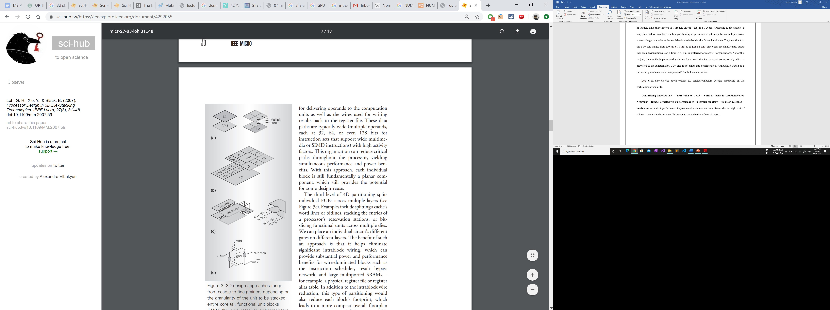
Related Work
3D Die-Stacking Techniques
Stacking Macroscopic Blocks
Stacking Functional Unit Blocks (FUBs)
Stacked Logic Gates
Stacked Transistors
Benefits: reduction in a multicore processor’s core-to-core interaction paths
Redesign effort: Reuse existing 2D
Example: Core-on-core, Cache-on-core
Benefits: Reduced latency and power of global routes
Redesign effort: Re-floorplan and retime paths
Example: ALU-on-ALU
Benefits: Elimination of intra-block wiring
Redesign effort: 3D circuit designs and layout tool development
Example: Cache splitting, ALU bit splitting
Benefits: reductions in areas, latency and power consumptions (max benefits)
Redesign effort: Almost no reuse
Example: NMOS/PMOS partitioning
Notes:
NOTES:
(
Need this slide to explain different Techniques with which we can create a 3D Design.
Flow-> Explain main observation: the deeper we go in the abstraction level to create 3D designs, the more the benefits, but the more complex the designing problem becomes. The re-design effort increases many-folds. Elaborate all the points in the slides – inform that we’ll be focusing on the first design (stacking macroscopic blocks)
)

Slide 8

Related Work
3D Architectures for Multi-Core
3D Mesh
3D-stacked Mesh
An extension of its 2D predecessor. Multiple layers connected using vertical links same as the intra-layer links.
The design generally consists of processing cores uniformly distributed across the N1xN2xN3 3D mesh. (external controllers directly connected to each node)
2x2x2 3D Mesh ⟹
num_cpus = 8
num_rows = 2
num_cols = 2
num_layers = 2
It integrates multiple layers of 2D Mesh networks by connecting them with a bus spanning (low-latency TSV links) the entire vertical distance of the chip.
The design generally consists of stacked layers of different node-types (e.g. stacking a shared-cache).
Area of die: ½ cores, ½ network components
∴ 2x2x3 3D Mesh ⟹
num_cpus = 4
num_rows = 2
num_cols = 2
num_layers = 3
Notes:
NOTES:
(
Need this slide to explain the subtle differences between 3D Mesh and 3D-stacked Mesh designs.
Flow-> elaborate the points mentioned in the slide – explain why it is recommended to have half the area of die allocated for network components only.
)
Stacking of multiple processors ⟹ heat dissipation

Slide 9
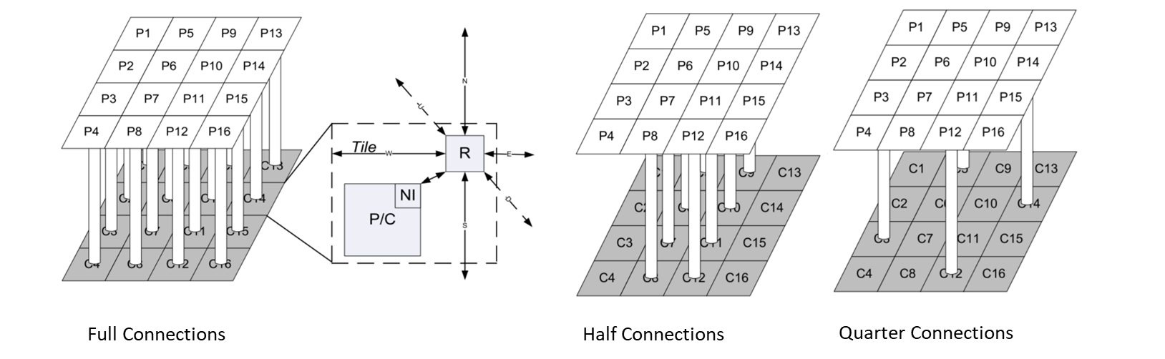
Related Work
Through Silicon Vias Placement
Max Performance by full “layer-layer” connections.
For 8x8 Mesh:
1.83e+18 possible half “layer-layer” connections.
4.88e+14 possible quarter “layer-layer” connections.
Approach: Search entire Design-space to choose most optimal TSV Placement configuration.
→ divide the NoC into smaller sub-sections to reduce the design space
Notes:
NOTES:
(
Need this slide to explain the need for finding the Optimal positions for TSV placement in a die.
Flow-> explain why TSV full-connections lead to max performance (shortest possible path to the next layer) – why we don’t want to have all TSV connections? (die-area limitations, TSVs are bigger than transistors, therefore take space) – inform that this becomes an space exploration and optimization problem – how we can keep track of position of TSVs (explain the figure) – number of possible configurations in 8x8 Mesh according to authors. – authors’ conventional approach (division of NoC into sub-sections).
)

Slide 10
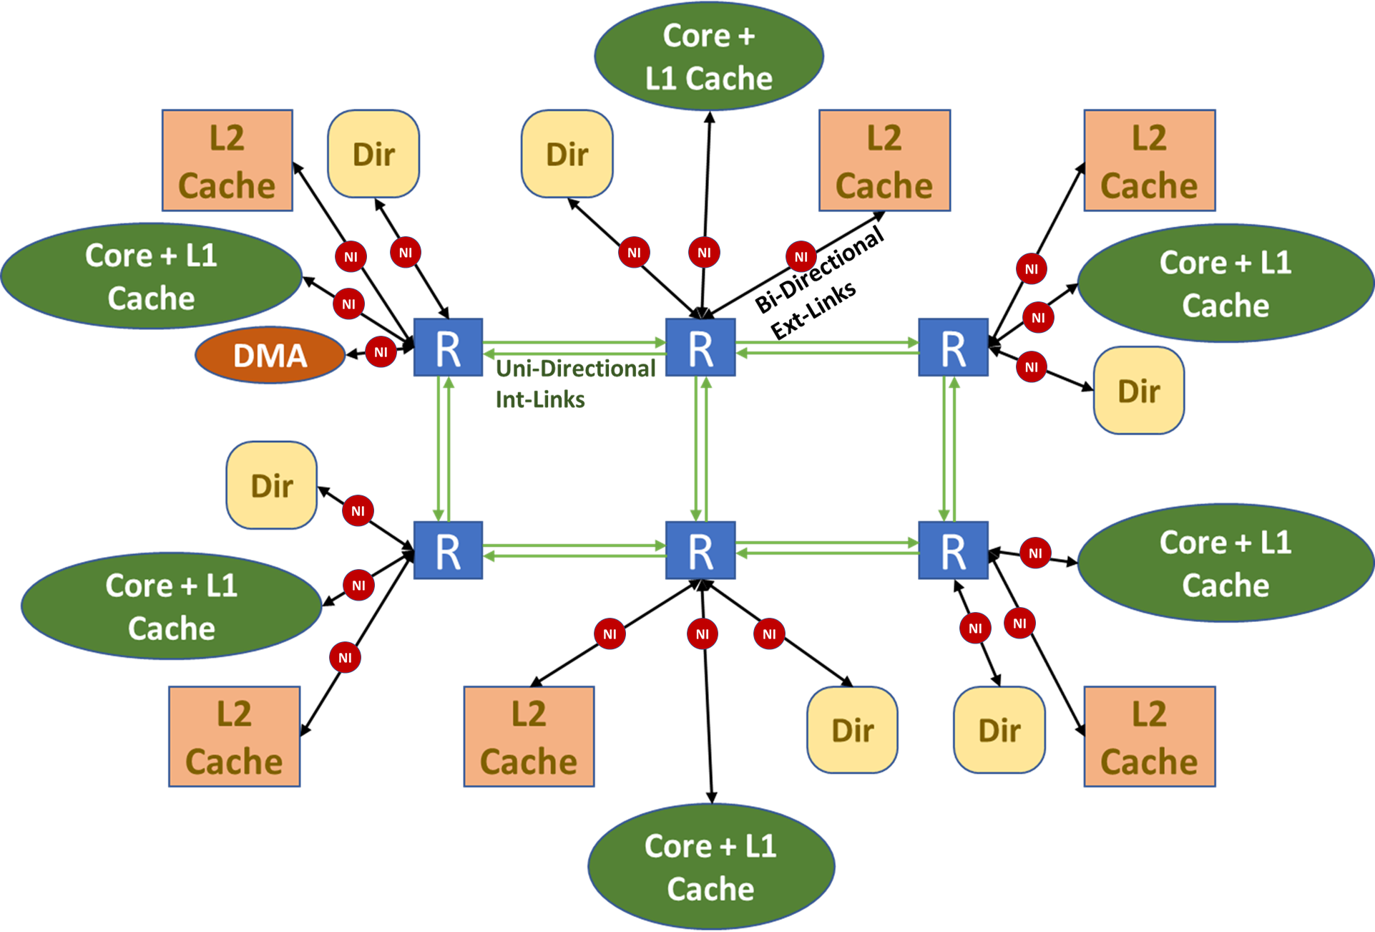
Garnet Network Model
Network Interface: Instances of “NetworkInterface” class.
Connects One Coherence controller to Network Routers
Router object connects to other network components using links
The “GarnetNetwork” class generates a network object which instantiates objects of other network components (network interface, routers, links).
Garnet’s “Topology” class enables heterogeneous topology designs
Topology class calls the methods to attach external and internal links for “Network Interface-routers” and “routers-routers” respectively according to user’s NoC layout
External Links: Instances of “GarnetExtLink” class.
Connections to other components
(Bidirectional Links)
Internal Links: Instances of “GarnetIntLink” class.
router-to-router connections
(Uni-Directional Links)
Notes:
NOTES:
(
Need this slide to explain the Garnet Network Model that is the Network-on-Chip model in gem5 framework.
Flow-> brief overview of the diagram – explain and elaborate each comment-box
)
(GarnetNetwork is a class, it makes network object which requires objects of Network Component classes as its argument – Topology class helps in delivering the required arguments – Since topology lays down the structure of the NoC, therefore, Topology class in Gem5 is responsible to instantiate objects of every network components required in the network (Router, Int-Link, Ext-Link, etc.) and connect them together. – Also explain, since we need to connect l1 and l2 controllers in the network, those are inherited by the network itself and passed-on to the Topology class while calling it. Basically, the cache-coherence generates and delivers the cache nodes and DMA nodes and dir nodes to the network. – Topology connects the nodes – explain about each class objects).

Slide 11
Contents
Introduction
Related Work
3D Die-Stacking Techniques
3D Architectures for Multi-Core
Through Silicon Vias Placement
Garnet Network Model
Three-dimensional NoC Implementation
3D Mesh NoC
3D-stacked Mesh NoC
Optimal TSV-Link Placement
Program Flow
Simulation Results
Conclusion and Future Work
References

Slide 12
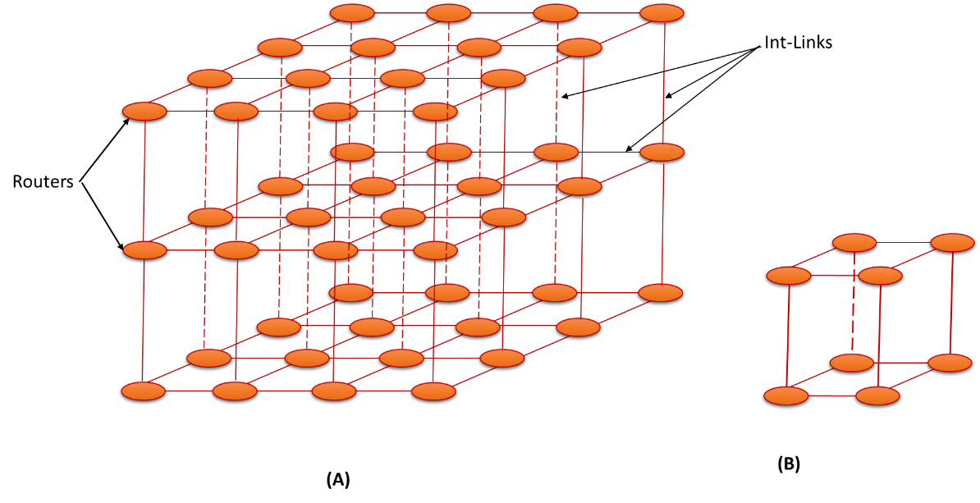
NoC Implementation
3D Mesh
N x N x M 3D mesh = N * N * M CPUs
Equal Latency and Bandwidth of every Internal Link (including vertical-links)
External Controller nodes connected to each router using External Links
num-routers = num-cpus
3D-Mesh NoC Designs. (A) 4x4x3 3D-Mesh (B) 2x2x2 3D-Mesh
Symmetric by design, but
Easy to design Asymmetric 3D-Mesh
Notes:
NOTES:
(
Need this slide to explain our implementation of the 3D Mesh model we discussed before.
Flow-> brief overview of the diagram – explain and elaborate each comment-box
)

Slide 13
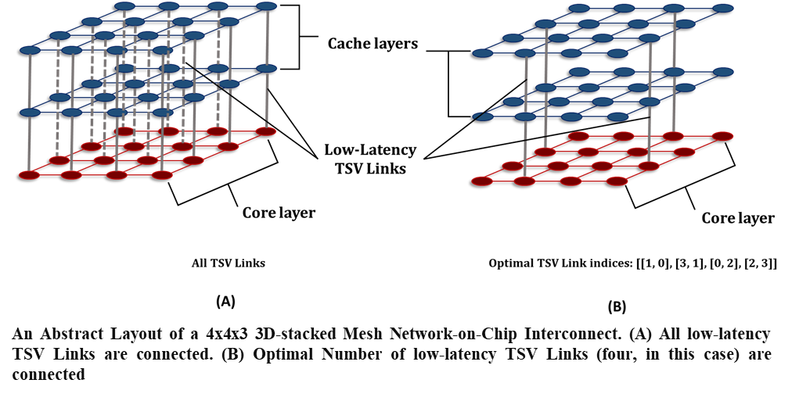
NoC Implementation
3D-Stacked Mesh
Cache layers
Dedicated Layers for Specific Node-Types
Low-Latency TSV Links
TSVs have higher bandwidth (on gem5 Simple-Network)
Core layer
Core layer
An Abstract Layout of a 4x4x3 3D-stacked Mesh Network-on-Chip Interconnect. (A) All low-latency TSV Links are connected. (B) Optimal Number of low-latency TSV Links (four, in this case) are connected.
Number of layers = 3; by design due to practical limitations (temperature & die-area).
Calculates Optimal TSV-Links by calling sub-routine.
Notes:
NOTES:
(
Need this slide to explain our implementation of the 3D-stacked Mesh model we discussed before.
Flow-> brief overview of the diagram – explain and elaborate each comment-box – later I’ll be showing a brief pseudo code to help understand where the sub-routine is being called – Also mention that subroutine can be replaced by call to any other space exploration technique (one of the usability of our code).
)

Slide 14
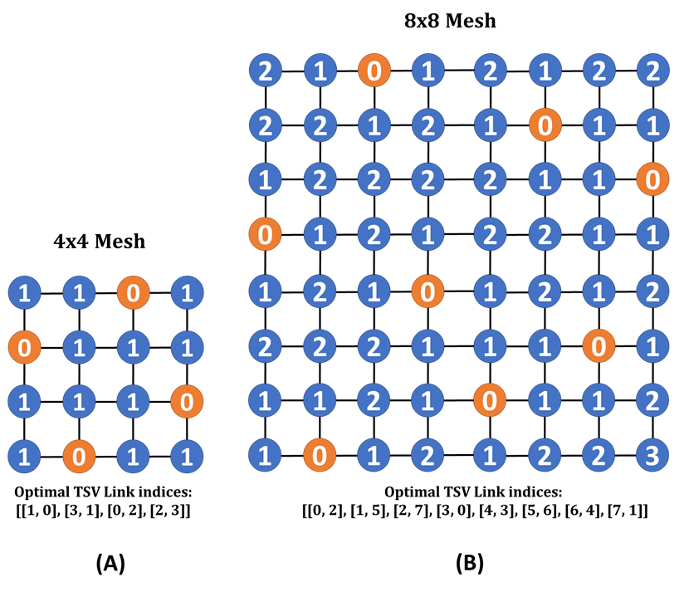
NoC Implementation
Optimal TSV Link Placement
Space Exploration Optimization problem: The least number of TSVs for the maximum possible performance ⟹ minimization of average hop count.
Assumptions: (dramatically shortens the no. of possible configurations to explore)
No two TSVs in same row.
No two TSVs in same column.
No two TSVs in same diagonal.
Outputs a fixed configuration for value of ‘N’ in a NxN mesh.
Branch and Bound approach akin to N-Queens Problem.
This approach restricts the number of TSVs in the grid and automatically places them in the position of minimum possible hop count for a node.
Flexible code written to accommodate other methods of Optimal TSV placement.
Packet Hop values from each Network-Node to a nearest TSV link in (A) 4x4 Mesh and (B) 8x8 Mesh.
Notes:
NOTES:
(
Need this slide to explain our implementation of the Optimal TSV Link placement technique.
Flow-> abstract explanation of the technique – show the figure and explain what I meant (tell that better approaches might exist but this one is faster and gives relatively same results) – elaborate and explain each point in slide.
)

Slide 15
NoC Implementation
Program Flow
Notes:
NOTES:
(
Purpose of this slide is to explain the pseudo-code for setting the layout of the 3D NoC.
Flow-> line-by-line explanation of the code (More emphasis on line that calls Generate TSV Link Positions).
)

Slide 16
Contents
Introduction
Related Work
3D Die-Stacking Techniques
3D Architectures for Multi-Core
Through Silicon Vias Placement
Garnet Network Model
Three-dimensional NoC Implementation
3D Mesh NoC
3D-stacked Mesh NoC
Optimal TSV-Link Placement
Program Flow
Simulation Results
Conclusion and Future Work
References

Slide 17
Evaluation Methodology
Parameters to set the Number of Network-Nodes to be generated
Sets the Default Network-on-Chip framework to be used by gem5 simulator
Options: “garnet2.0” & “simple”
Set the Network Topology to be used by the gem5 simulation.
Can be 2D or 3D.
3D Topology options: “Mesh_3D”, “Mesh_stacked” & “Mesh_stacked_OptimalTSVs”
Run Full-system simulations by changing the network-defining parameters.
Collect “network.average_hops”, “sim_ticks” and “sim_insts” from “stats.txt”.
Average CPI = (sim_ticks/sim_insts)
Average Hop Count = network.average_hops

Slide 18
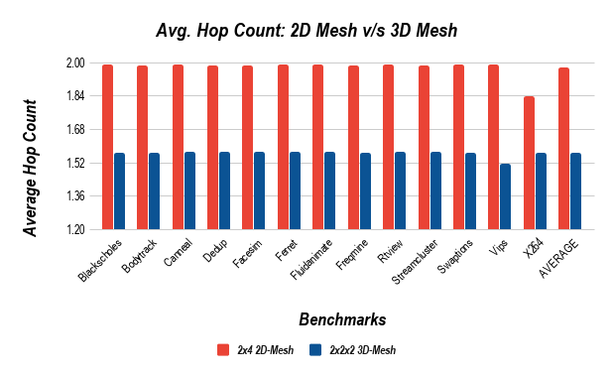
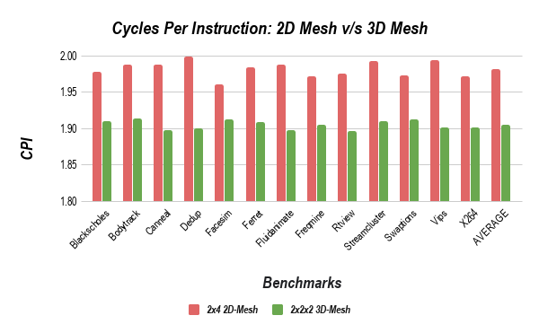
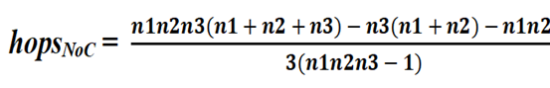
Simulation Results
1.9770
1.9821
1.5661
1.9055
Evaluated on PARSEC Benchmark suite.
Total number of internal links (in one direction) in the model = N₁N₂(N₃ - 1) + N₁N₃(N₂ - 1) + N₂N₃(N₁ - 1)
2x2x2 3D Mesh v/s 2x4 2D Mesh:
About 21% on average reduction in Average hop-count.
Reduced values of average CPI for all benchmarks. Signifies better performance.
Values of Hop-count follow the metric , with 5-8% smaller values.
Notes:
NOTES:
(
Purpose of this slide is to show the results obtained and analyze them to prove the validity of the implementation.
Flow-> Demonstrate the results in the chart – Compare the performance obtained for 2D and 3D Meshes – Compare CPI – Validate by describing the formula and stating that num Int-Links in one direction is equal to the formula result and it can be verified by config.ini file that lists the objects names for each link created whether external or internal – tell about hop-count formula – state that it is for zero-load network but model still provides close enough results.
)

Slide 19
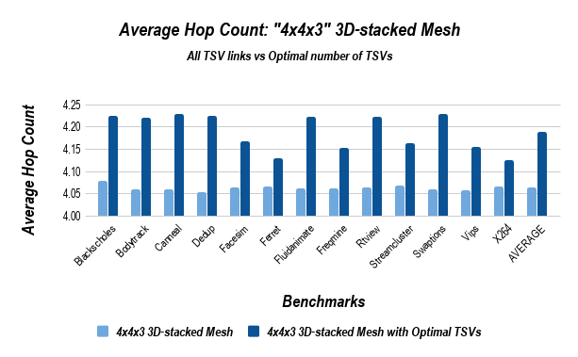
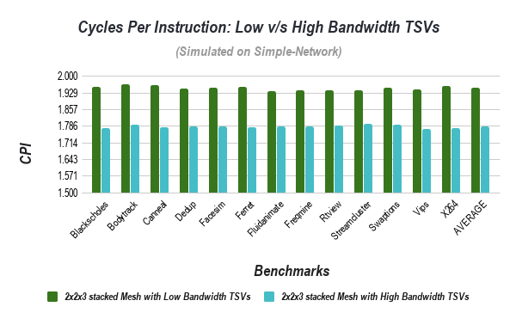
Simulation Results (cont.)
1.9499
4.1898
1.7849
4.0635
Around 3-4% increment in the average hop-count values compared to the naïve 3D-stacked Mesh.
Very slight increment in the hop count reflects the efficiency of the approach.
High-Bandwidth TSV model: thrice the bandwidth than the rest of the internal links.
8-9% average reduction in Average CPI values. Signifies Greater performance of High-Bandwidth model.
Simulated on gem5 Simulator’s “SimpleNetwork” framework.
Notes:
NOTES:
(
Purpose of this slide is to show the results obtained and analyze them to prove the validity of the implementation.
Flow-> Demonstrate the chart with Average Hop-Count for 3D Stacked mesh with and without all TSV links – compare the results – talk about the efficiency of the TSV placement algorithm - read through the points in slide while explaining them – Demonstrate chart with CPI values for low/high bandwidth TSVs – compare the results – read through the points – state the fact that since the code is designed such that it runs on both the network modes, this one is run on simple network because the GARNET network does not let us set individual bandwidth for the links.
)
IMPORTANT: Add execution time for TSV placement method for 4x4 mesh to show that the search space was considerably shorter making the program faster. Thus, a workaround for avoiding the original authors’ technique of searching 10^14 possibilities.

Slide 20
Conclusion & Future Work
In Summary
Demonstrated need for Network-on-Chips and discussed state-of-the-art research on 3D NoC Designs.
Implemented three variations of 3D-mesh NoC designs: 3D mesh, 3D-stacked Mesh and discussed the subtle differences in their structure.
Discussed a fast approach to extract Optimal TSV indices for the implementation of 3D-stacked Mesh with Optimal TSV links.
Discussed and analysed simulation results to verify correct working of the model.
Future Work
More decisive methods to validate 3D models.
Simulations for large NoC sizes.
Integration with Power models.
More Sophisticated approaches for Optimal TSV placement problem.
Implementation of other 3D NoC designs (other than Mesh designs).
Notes:
NOTES:
(
Purpose of this slide is to summarize the work and demonstrate the expected future work.
Flow-> Go through all the points in the slides (for every point, refer to the things we discussed for them)
)

Slide 21
References
N. E. Jerger, T. Krishna and L.-S. Peh, "On-Chip Networks,“ in On-Chip Networks, Morgan & Claypool, 2009.
G. H. Loh, Y. Xie and B. Black, "Processor Design in 3D Die-Stacking Technologies," IEEE Micro, vol. 27, no. 3, pp. 31-48, May-June 2007.
F. Denneman, "frankdenneman.nl," 7 July 2016. [Online]. Available: https://frankdenneman.nl/2016/07/07/numa-deep-dive-part-1-uma-numa/. [Accessed Friday May 2020].
B. S. Feero and P. P. Pande, "Networks-on-Chip in a Three-Dimensional Environment: A Performance Evaluation," IEEE Transactions on Computers, vol. 58, no. 1, pp. 32-45, Jan 2009.
J. Lowe-Power, "gem5 Documentation," gem5, [Online]. Available: http://www.gem5.org/documentation/. [Accessed Tuesday May 2020].
T. Krishna, "A Detailed On-Chip Network Model Inside a Full-System Simulator," Monday, September 2017. [Online]. Available: https://pdfs.semanticscholar.org/c1e9/0beac857ce1af1a531b6538804e71efdef05.pdf. [Accessed Tuesday May 2020].
T. C. Xu, P. Liljeberg and H. Tenhunen, "A study of Through Silicon Via impact to 3D Network-on-Chip design," in 2010 International Conference on Electronics and Information Engineering, Kyoto, 2010.
…

Slide 22


